Slide 1
Working with the VM, HTTP and Moodle
RDP
Desktop access
A practical session using RDP, SSH, PHP and browser tools
SSH
Terminal access
HTTP
Browser evidence
Moodle
Dynamic web system
Focus: understanding what the tools show

Slide 2
HTTP
HTTP is the communication system connecting the browser to the web server running inside the VM. POST and GET are two types of HTTP requests.
Browser
↓ HTTP GET or POST request
VM
↓
Apache/httpd receives the request
↓
PHP/Moodle processes it
↓ HTTP response
Browser displays the result
HTTP defines how the browser and web server communicate.

Slide 3
GET and POST requests
03
GET
Form values travel in the HTTP request body.
The browser is saying:
“Moodle, here are my login details. Please check them.”
POST
Form values normally appear in the URL query string.
The browser is saying:
“Moodle, please send me the login page.”
GET and POST are HTTP methods. They tell the server what kind of request the browser is making.

Slide 4
Browser Network tools
06
Request
Response
Timing
Method and URL
Request headers
Form or query data
Status code
Response headers
Returned content
Waiting time
Download time
Use of cache
Useful status codes
200
The server returned a successful response
304
The browser may reuse its cached copy
404
The requested resource was not found
5xx
The server encountered a problem
VM, HTTP and Moodle practical session

Slide 5
VM Introduction
A VM is a virtual computer. It has:
Its own operating system
Files and folders
Installed programs
Running processes
Network settings
The VM does not automatically provide Moodle. It must contain all the software needed to receive and process the requests.

Slide 6
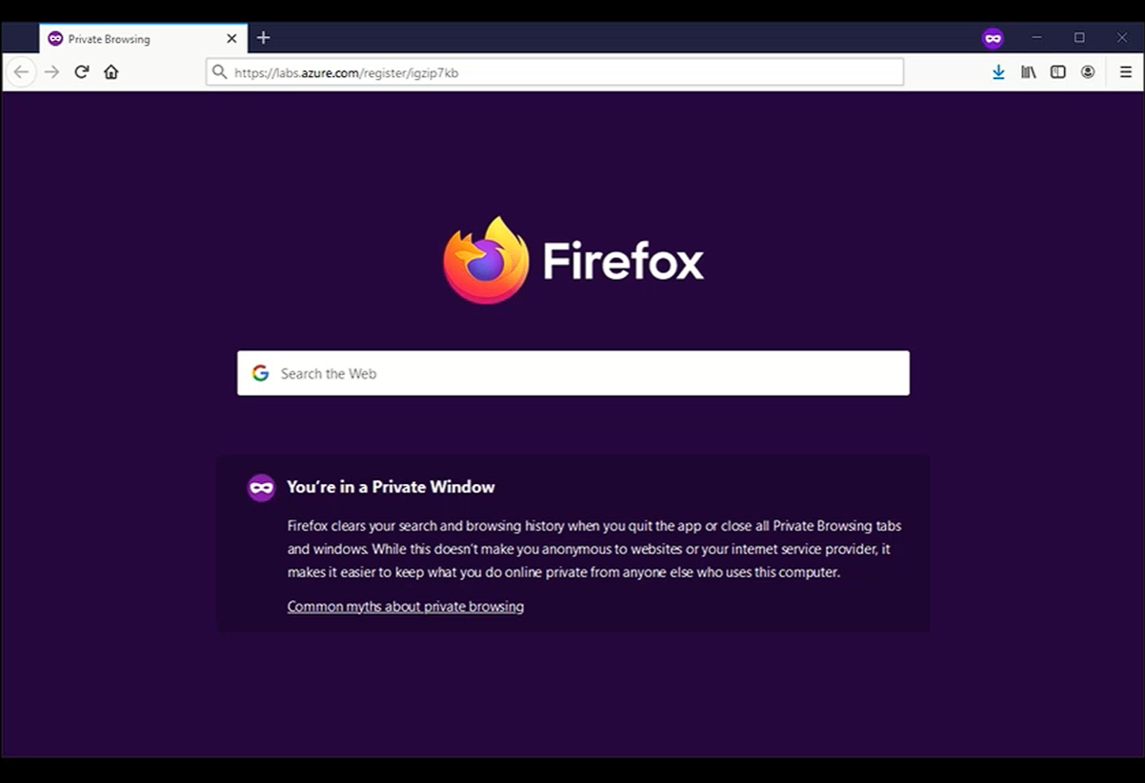

Slide 7
Two ways to access the VM
02
Remote Desktop (RDP)
Secure Shell (SSH)
Shows the VM's graphical desktop
Useful for the browser, file manager and visual tools
Transfers screen updates, mouse movements and keystrokes
Provides a command-line connection
Useful for checking services, reading logs and running database commands
Usually remains practical when the desktop connection is unstable
Both methods connect to the same VM and work with the same files and services.
VM, HTTP and Moodle practical session

Slide 8
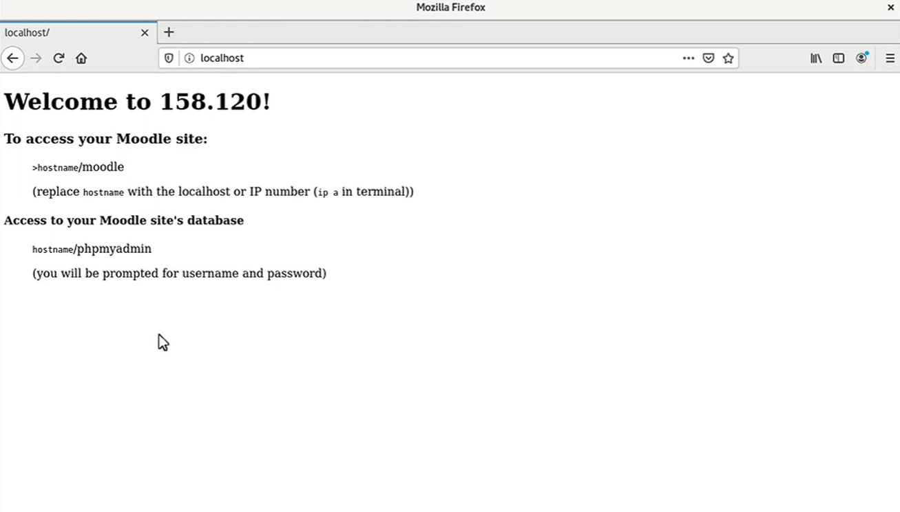

Slide 9
